Slide 1
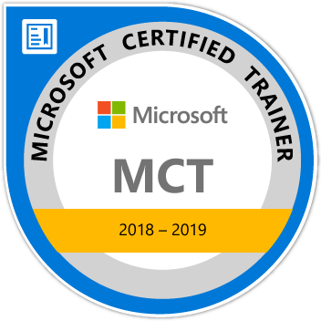
Learn MVC 6 Step by Step
Maruti Makwana
Microsoft Certified Trainer
www.microsofttrainer.in

Slide 2
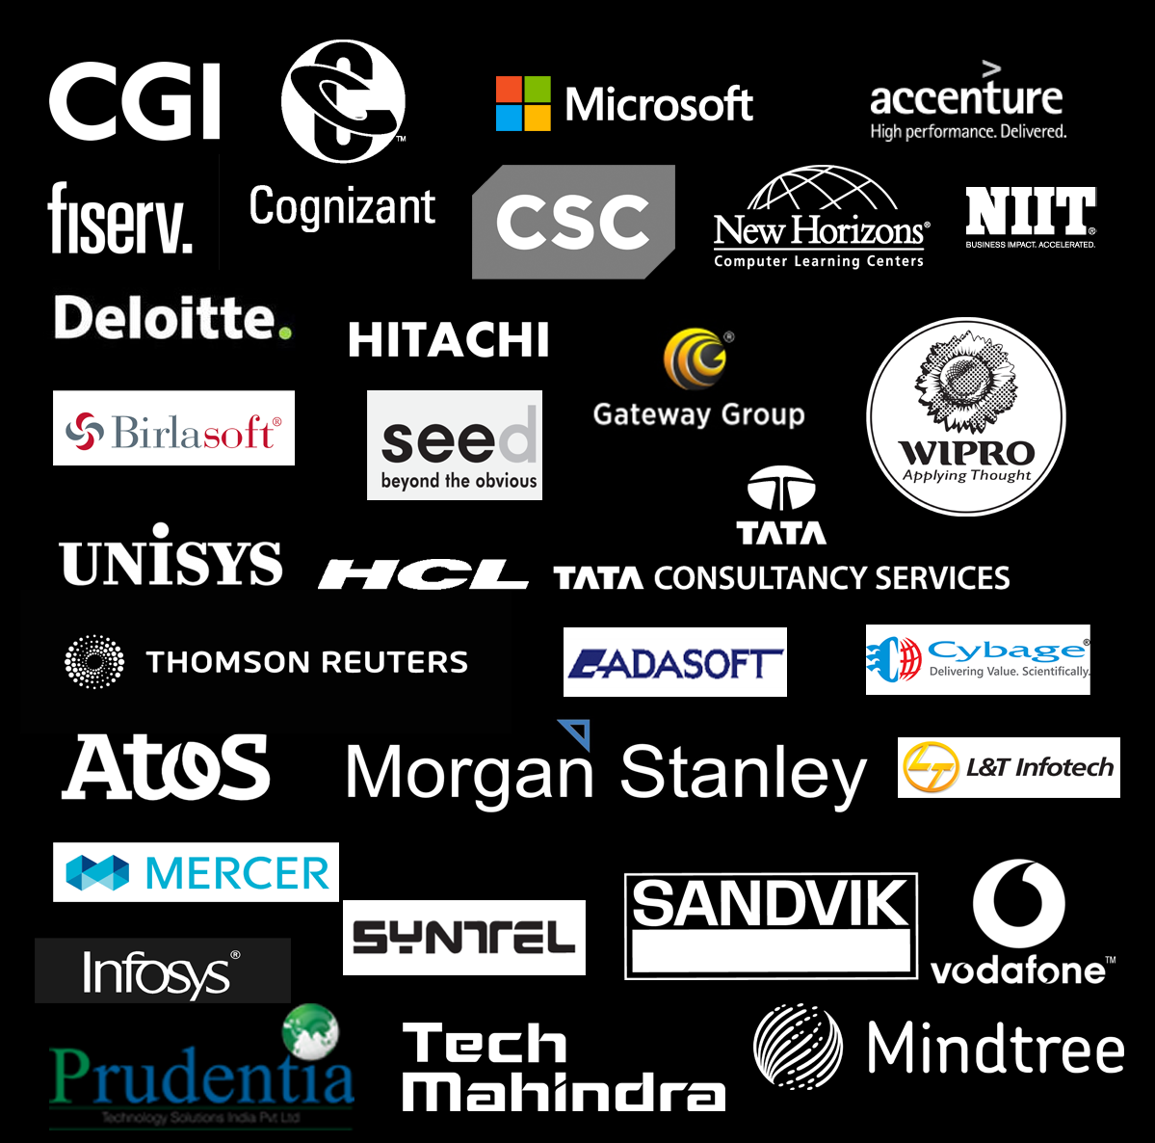


Slide 3
What is MVC?
What is MVC 6?
Which is based on dot net core framework
NOT on dot net framework

Slide 4
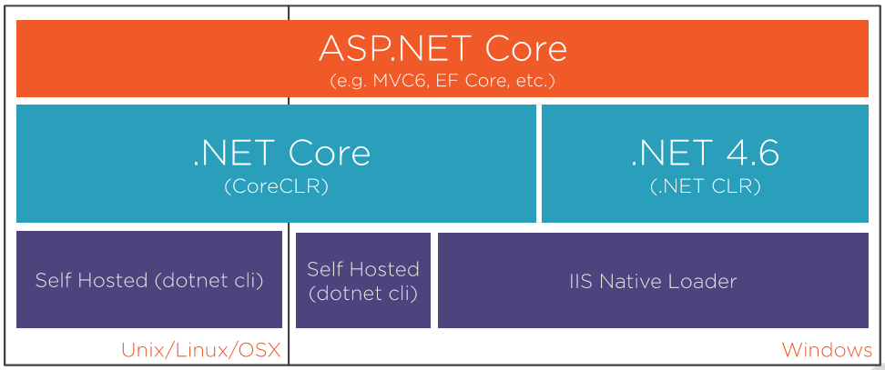

Slide 5
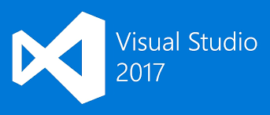



Required Tools and Software
Google Chrome

Slide 6
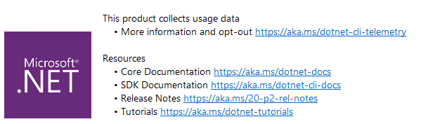

Slide 8
What is ASP .Net Core?
ASP.NET Core is an open source and cloud-optimized web framework for developing modern web applications that can be developed and run on Windows, Linux and the Mac.
It includes the MVC framework, which now combines the features of MVC and Web API into a single web programming framework.

Slide 9
Why to choose ASP. Net Core?
ASP.NET Core is an open source and cloud-optimized web framework for developing modern web applications that can be developed and run on Windows, Linux and the Mac.
It includes the MVC framework, which now combines the features of MVC and Web API into a single web programming framework.
ASP.NET Core apps can run on .NET Core or on the full .NET Framework.
It was architected to provide an optimized development framework for apps that are deployed to the cloud or run on-premises.

Slide 10
Why to choose ASP. Net Core?
ASP.NET Core apps can run on .NET Core or on the full .NET Framework.
It was architected to provide an optimized development framework for apps that are deployed to the cloud or run on-premises.
Built-in support for dependency injection.
Tag Helpers which makes Razor markup more natural with HTML.
The benefits of a smaller app surface area include tighter security, reduced servicing, improved performance, and decreased costs

Slide 11
Before ASP.Net Core let’s See.Net Core

Slide 12
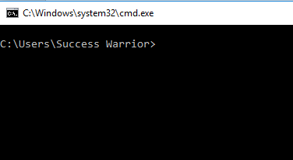
Let’s Understand dotnet code with simple application
Open
Command
prompt

Slide 13
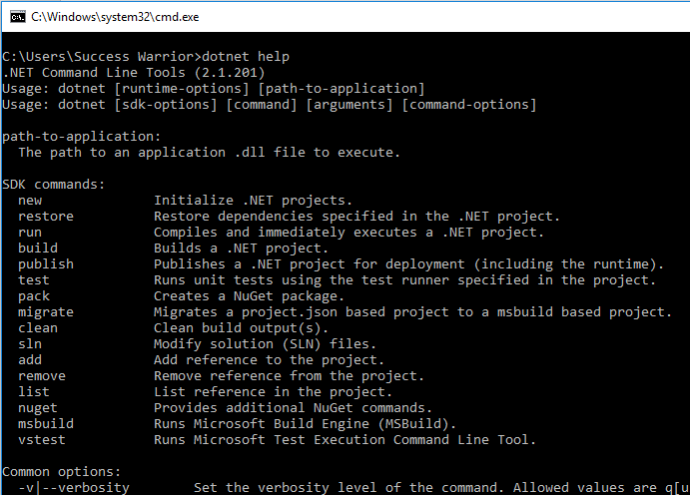

Slide 14
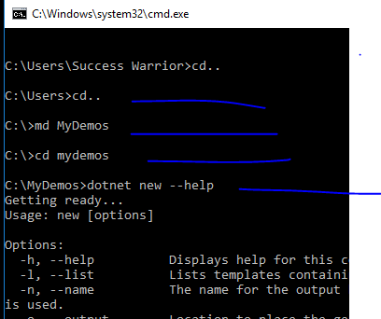

Slide 15
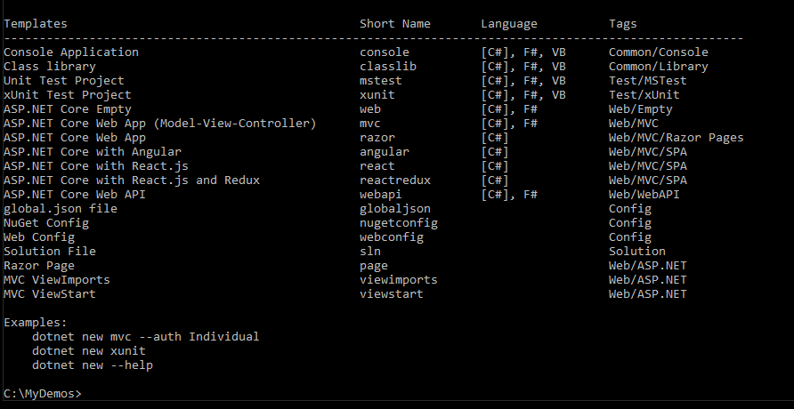
We can create any of these projects using dotnet command

Slide 16
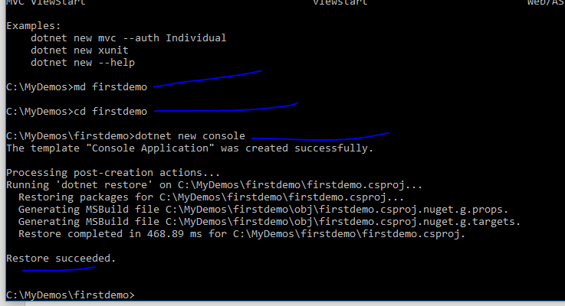
We created new console applicaiton

Slide 17
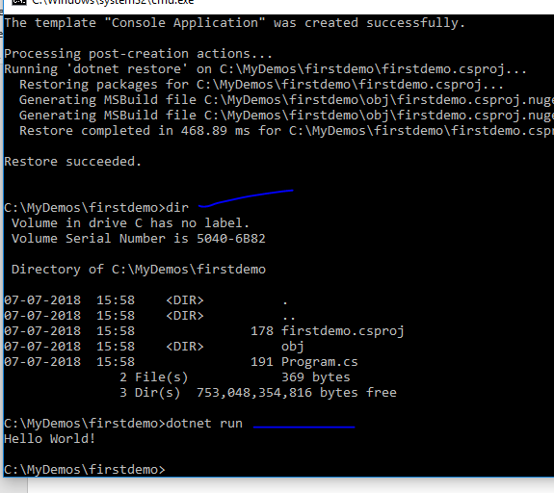
We got new project with very simple project
And its running

Slide 18
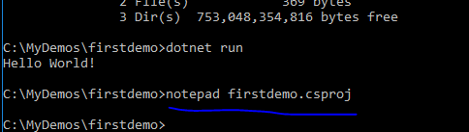
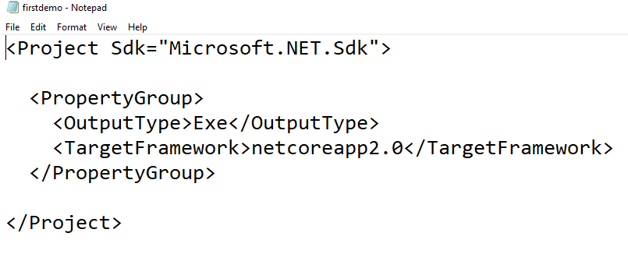
A very simple
csproj file

Slide 19
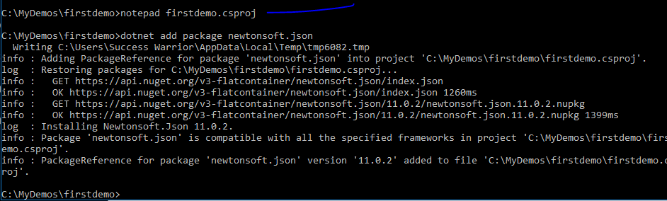
Adding new package using npm

Slide 20
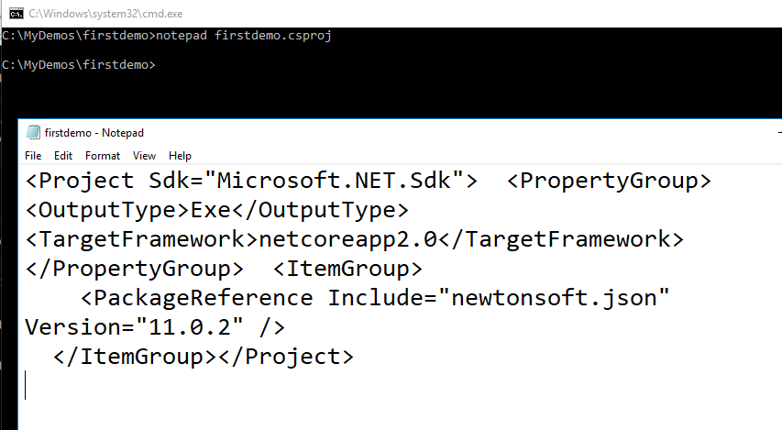
Csproj file will get changed and package is added

Slide 21
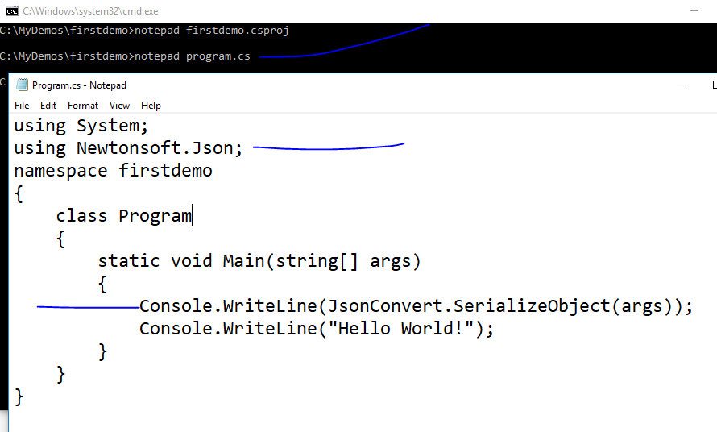

Slide 22
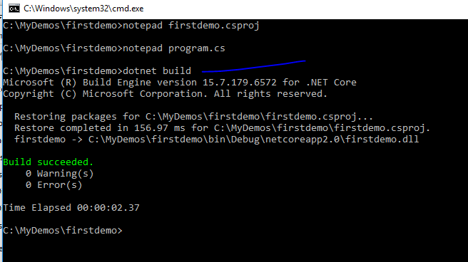

Slide 23
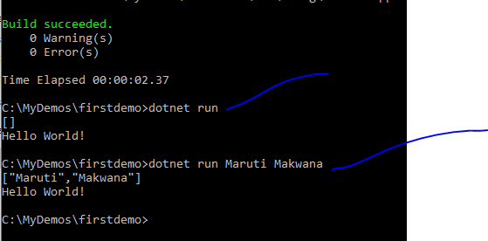

Slide 24
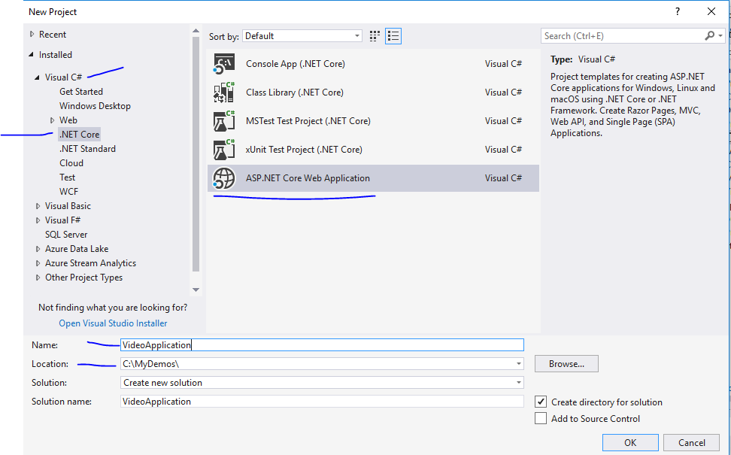

Slide 25
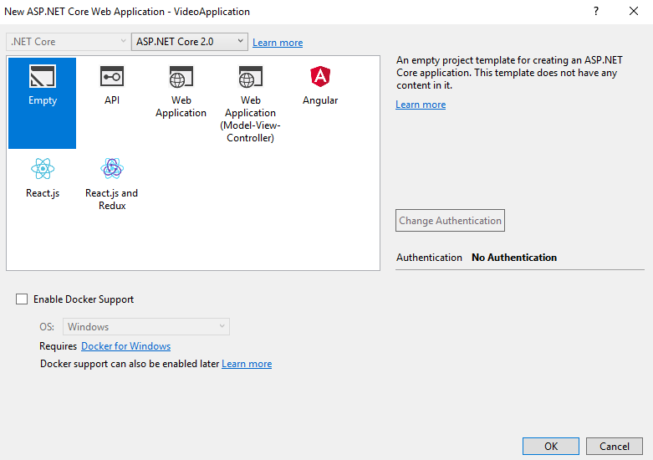

Slide 26
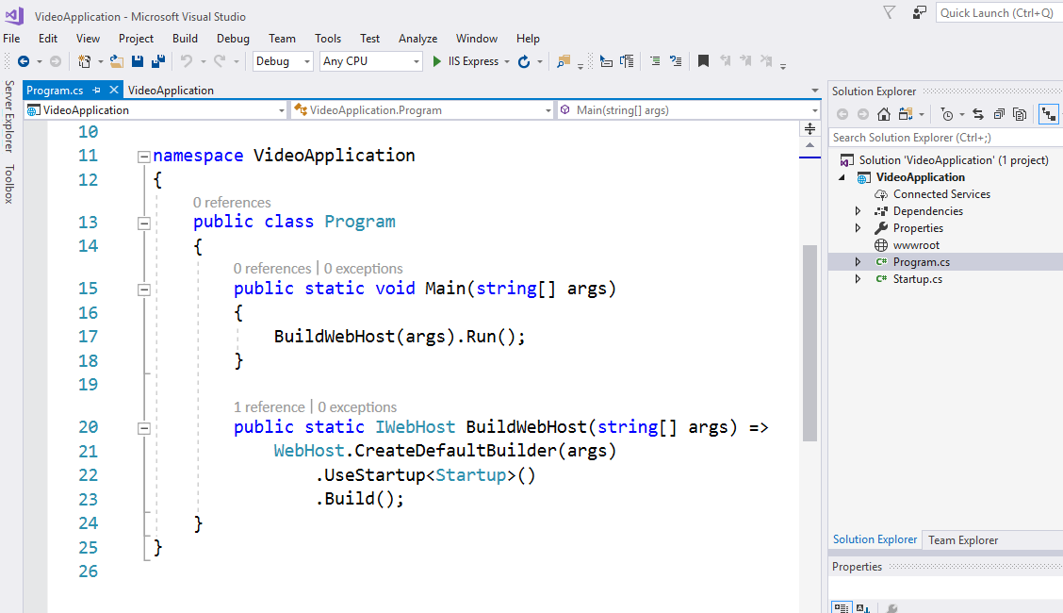

Slide 27
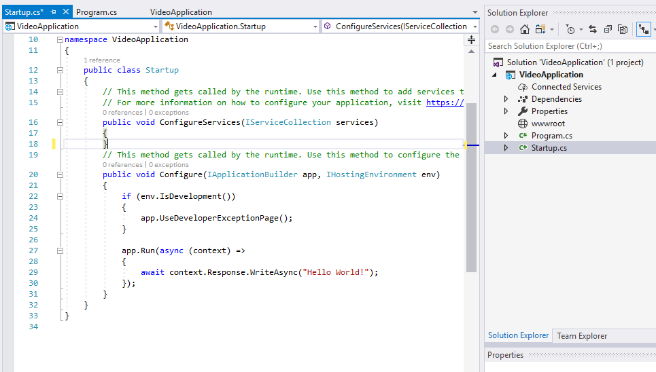
For any request that comes in just write out helloworld

Slide 28
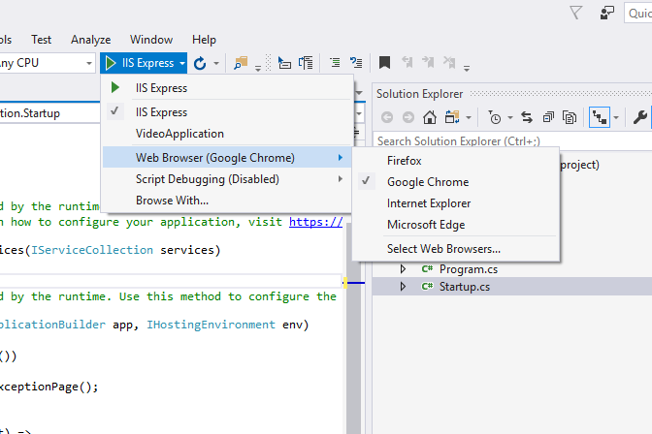

Slide 29
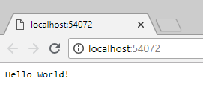
Even if you check view source this is just text
Which we are returning – No html page till now

Slide 30
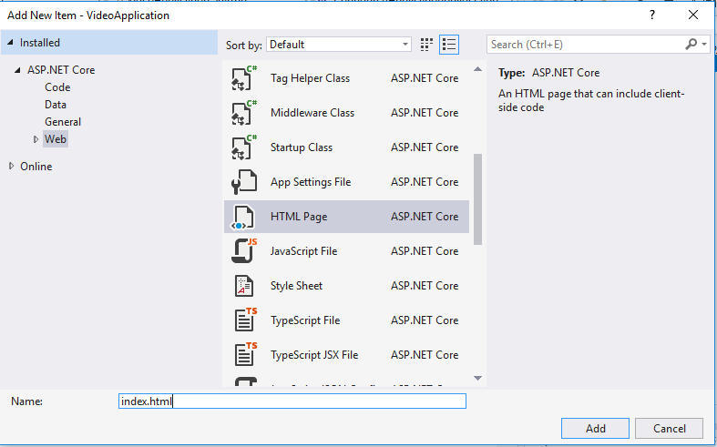

Slide 31
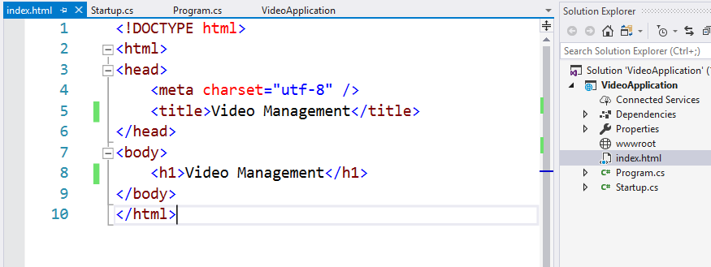

Slide 32
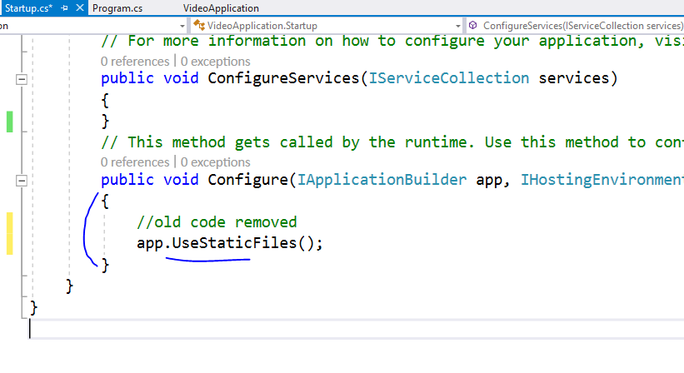

Slide 33
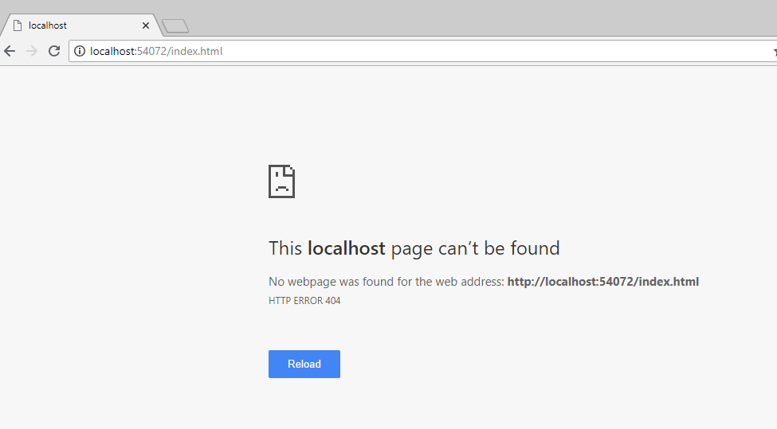
Ooops !!

Slide 35
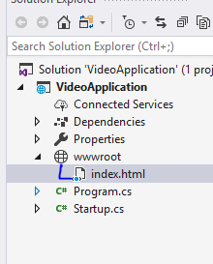
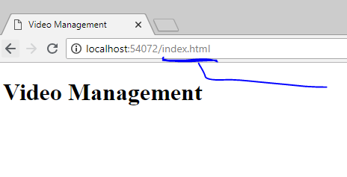
Move index file into wwwroot

Slide 36
All your JS, CSS, HTML and font files will
Always go inside wwwroot folder only

Slide 37
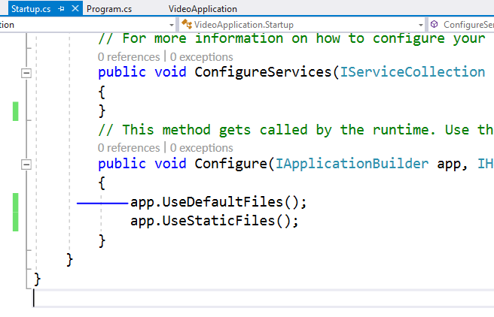
To serve html in this directory please add this
This order is important because
Middleware works based on that

Slide 38
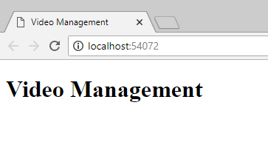
Now index page is visible on base URL

Slide 39
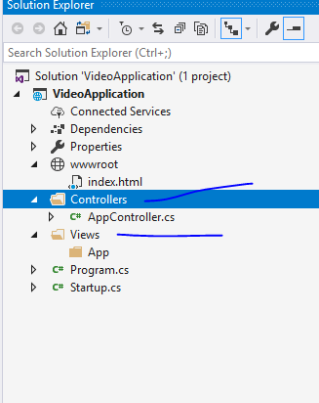
Add folders like this

Slide 40
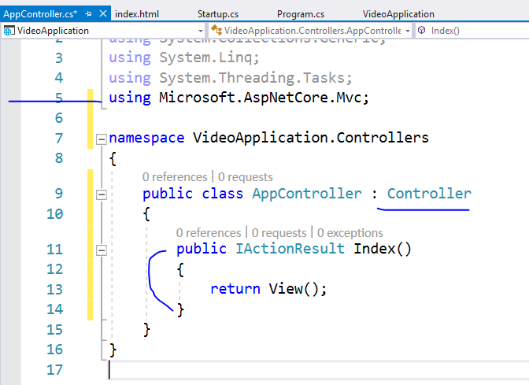
Add code
like this

Slide 41
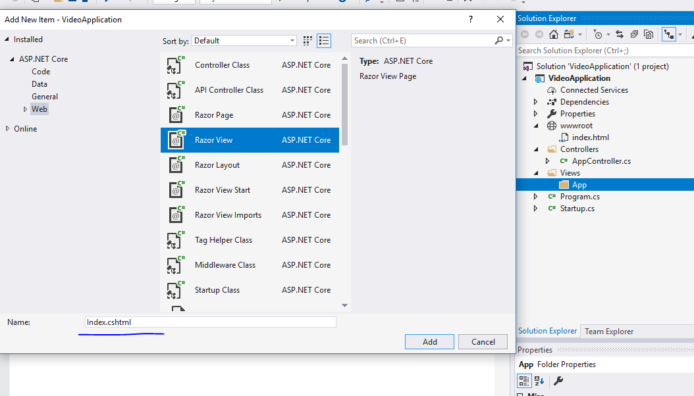

Slide 42
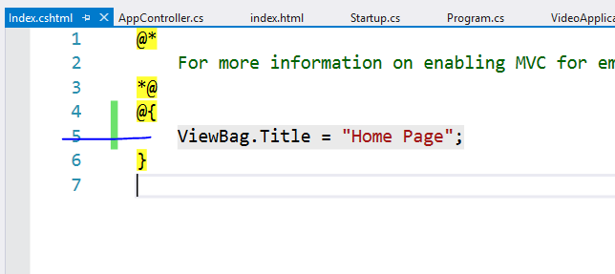

Slide 43
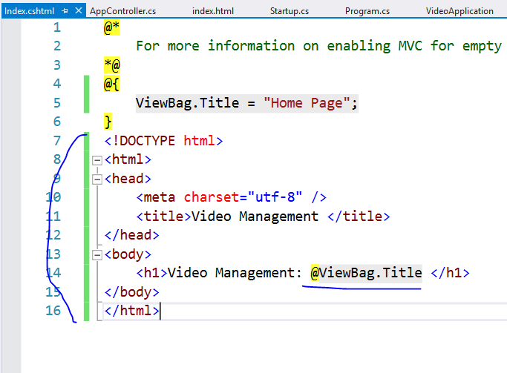

Slide 44
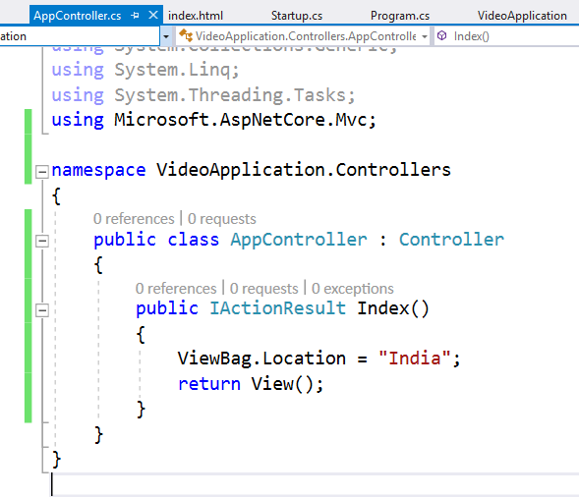

Slide 45
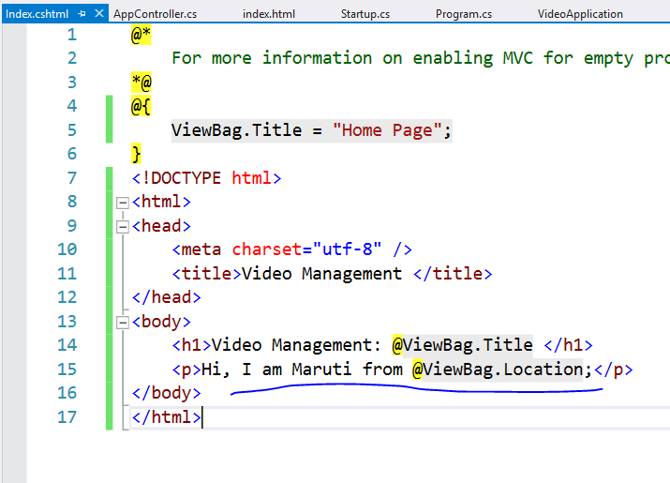

Slide 46
This will not run controller right now
Because we have not enabled MVC in this project
Let’s do it now

Slide 47
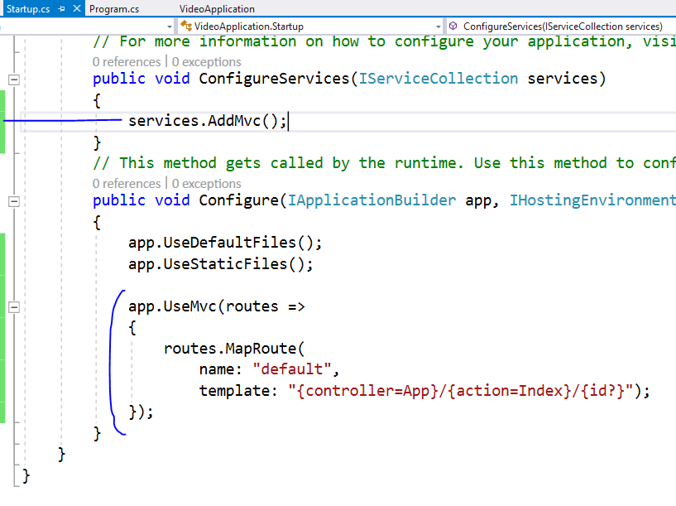

Slide 48
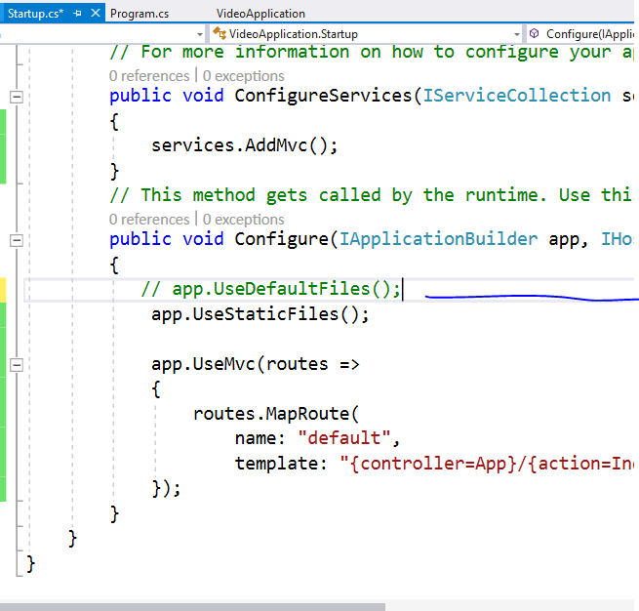
Comment this as
We don’t want to follow
File system path

Slide 49
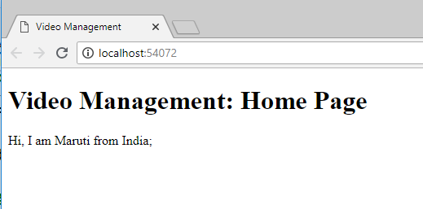

Slide 50
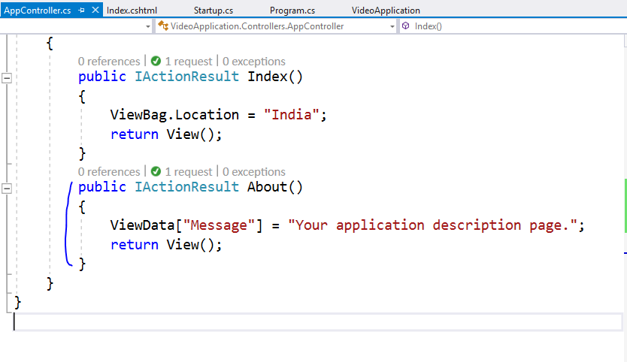

Slide 51
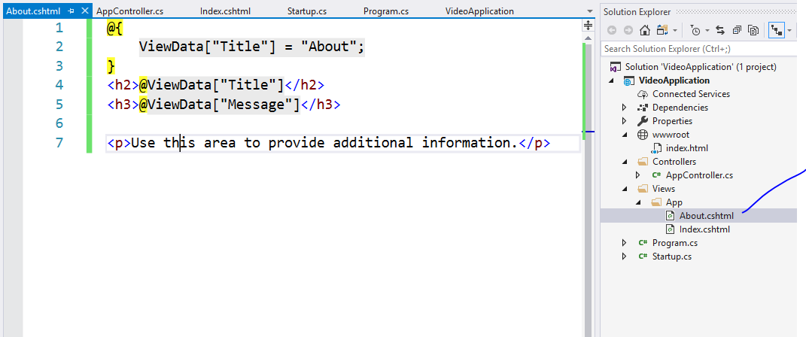

Slide 52
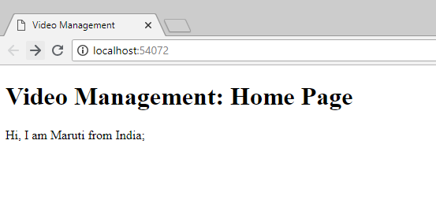
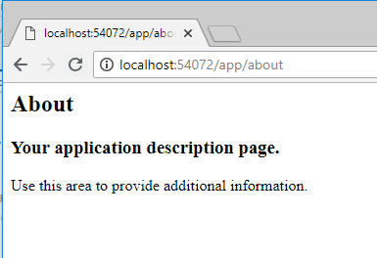
Type this url

Slide 53
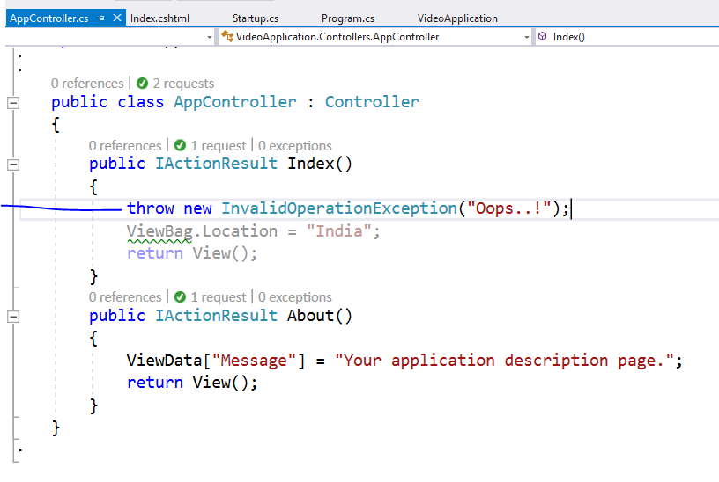
Add this line and run using ctrl + F5

Slide 54
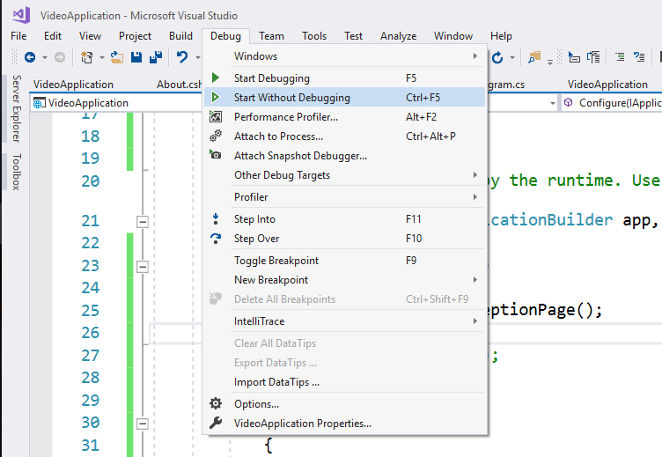

Slide 55
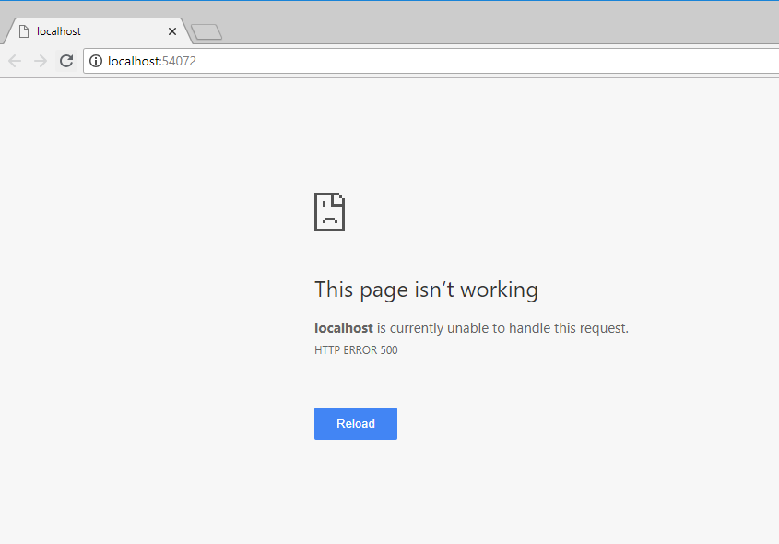
You will not get exception details

Slide 56
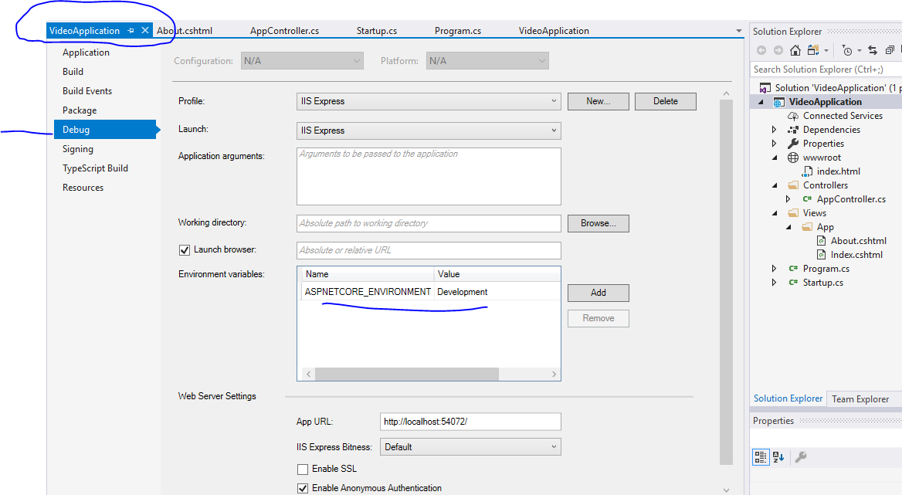

Slide 57


Slide 58


Slide 59


Slide 60


Slide 61


Slide 62


Slide 63

Remove extra things

Slide 64


Slide 65


Slide 66


Slide 67


Slide 68


Slide 69


Slide 70


Slide 71

Whatever you add here will be referred in
All the views

Slide 72


Slide 73


Slide 74


Slide 75


Slide 76


Slide 77


Slide 78

Change it to production

Slide 79
Now we are going to create Razor Page

Slide 80

Add new folder and new page

Slide 81

Pages do not require controllers

Slide 82



Slide 83

We added
2 contact actions

Slide 84


Slide 85


Slide 86


Slide 87





Slide 88


Slide 89


Slide 90



Slide 91


Slide 92
Now lets use tag helpers for same

Slide 93


Slide 94


Slide 95

Even if you click on lable it will
Focus on textbox because of
Asp-for

Slide 99
Validation : skip

Slide 100


Slide 101


Slide 102

If you want to display
Summary on top then
Set
Asp-validation-summary=“All”

Slide 107
S.O.L.I.D Principles
S stands for SRP (Single responsibility principle)
-Concerned about single focused purpose
O stands for OCP (Open closed principle)
-Open for extension but Closed for modification
L stands for LSP (Liskov substitution principle)
-the parent cannot replace the child object seamlessly
I stands for ISP ( Interface segregation principle)
-any Interface should not force any method to class which is implementing it
D stands for DIP ( Dependency inversion principle)
-Objects should be loosely coupled and injection should happen at runtime

